Slide 1
MOBILE SHOP

Slide 2
TABLE DESIGN TABLE NAME:ADMIN
FIELD | DATA TYPE | SIZE | CONSTRAINT
Admin id | Int | 10 | Primary key
Username | Varchar | 30 | Not null
password | Varchar | 30 | Not null

Slide 3
TABLE NAME:EMPLOYEE
FIELD | DATA TYPE | SIZE | CONSTRAINT
Employee id | Int | 10 | Primary key
Name | Varchar | 20 | Not null
Mobile | Int | 10 | Not null
Age | Int | 5 | Not null
Gender | Varchar | 6 | Not null
Salary | Int | 5 | Not null

Slide 4
TABLE NAME:CUSTOMER
FIELD | DATA TYPE | SIZE | CONSTRAINT
Id | Int | 10 | Primary key
Name | Varchar | 20 | Not null
Mobile | Int | 10 | Not null
Alternate | Int | 10 | Not null
Address | Varchar | 30 | Not null
Gender | Varchar | 10 | Not null

Slide 5
TABLE NAME:MOBILE
FIELD | DATA TYPE | SIZE | CONSTRAINT
Mobile id | Int | 10 | Primary key
Mobile model | Varchar | 20 | Not null
Mobile brand | Varchar | 20 | Not null
Price | Int | 5 | Not null
RAM | Int | 5 | Not null
CAMERA PX | Int | 5 | Not null
STORAGE | Varchar | 10 | Not null

Slide 6
TABLE NAME:PURCHASE
FIELD | DATA TYPE | SIZE | CONSTRAINT
Purchase id | Int | 10 | Primary key
Product id | Int | 10 | Foreign key
Quantity | Int | 5 | Not null
Details | Varchar | 30 | Not null
Date | Date | 10 | Not null

Slide 7
TABLE NAME:SALES
FIELD | DATA TYPE | SIZE | CONSTRAINT
Sales id | Int | 10 | Primary key
Customer id | Int | 10 | Foreign key
Product id | Int | 10 | Foreign key
quantity | Int | 5 | Not null

Slide 8
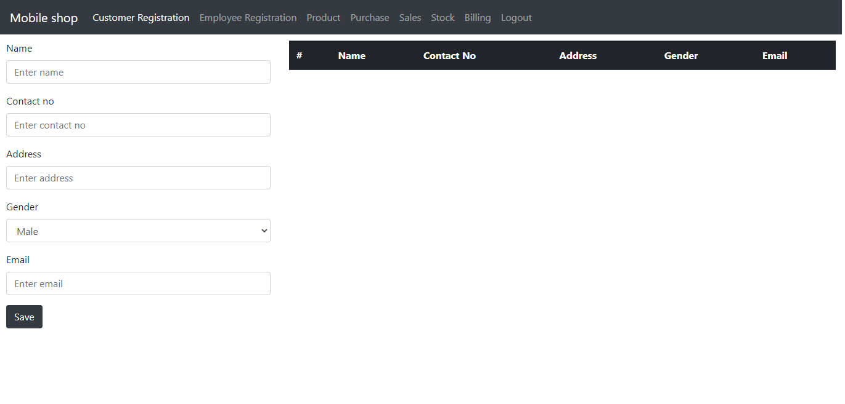

Slide 9
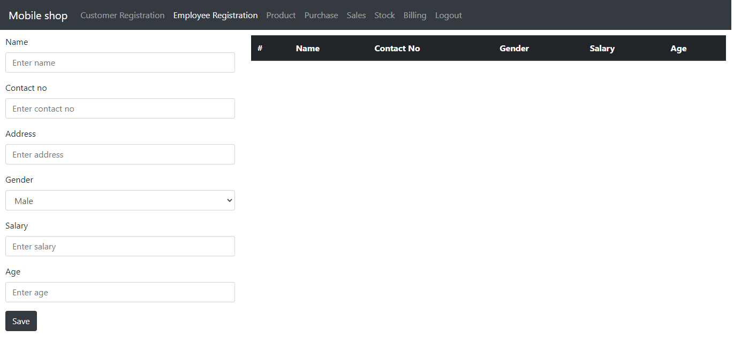

Slide 10
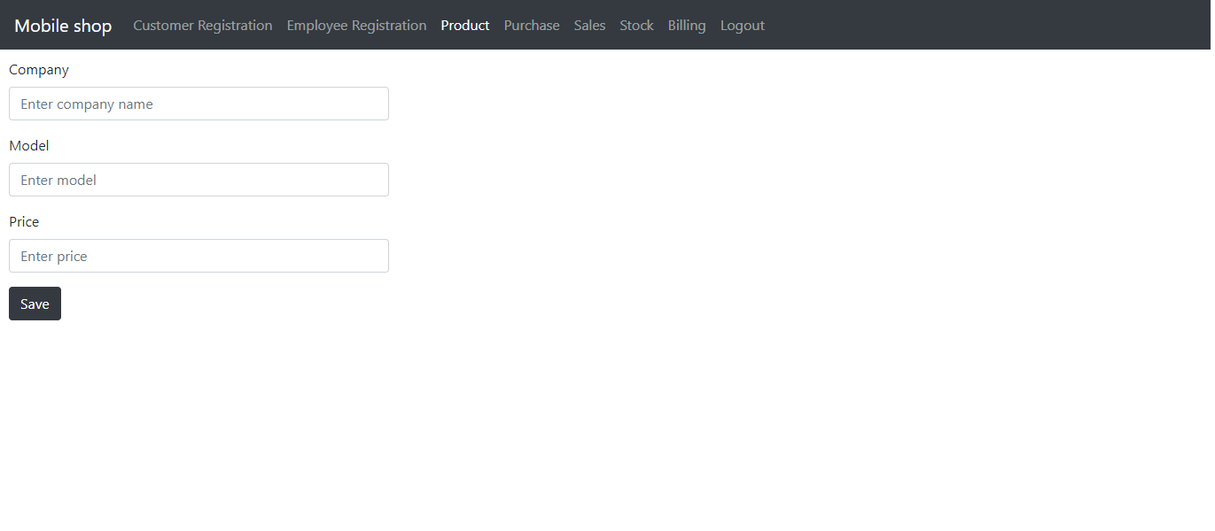

Slide 11
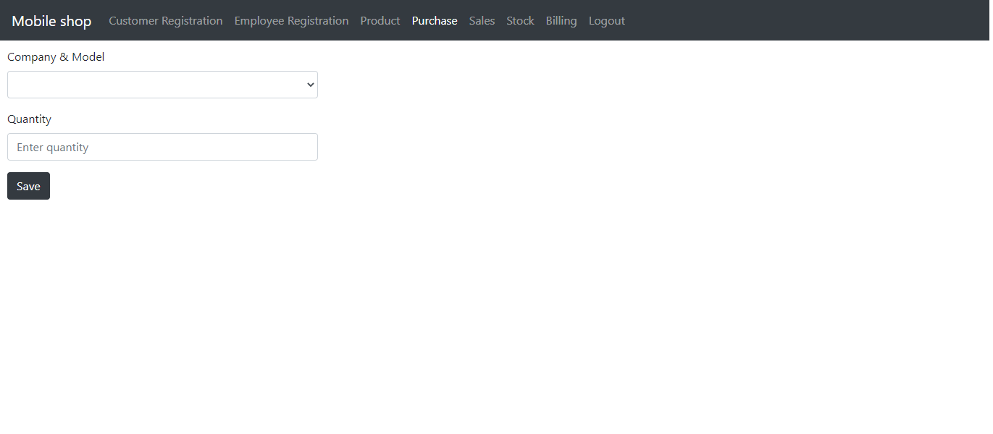

Slide 12


Slide 13
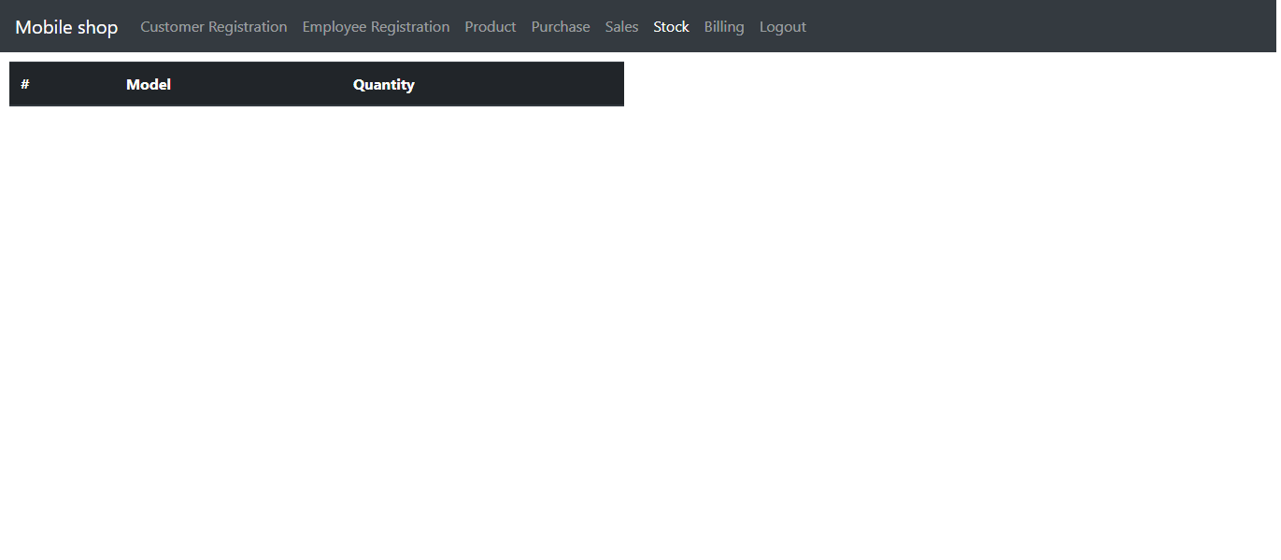

Slide 14
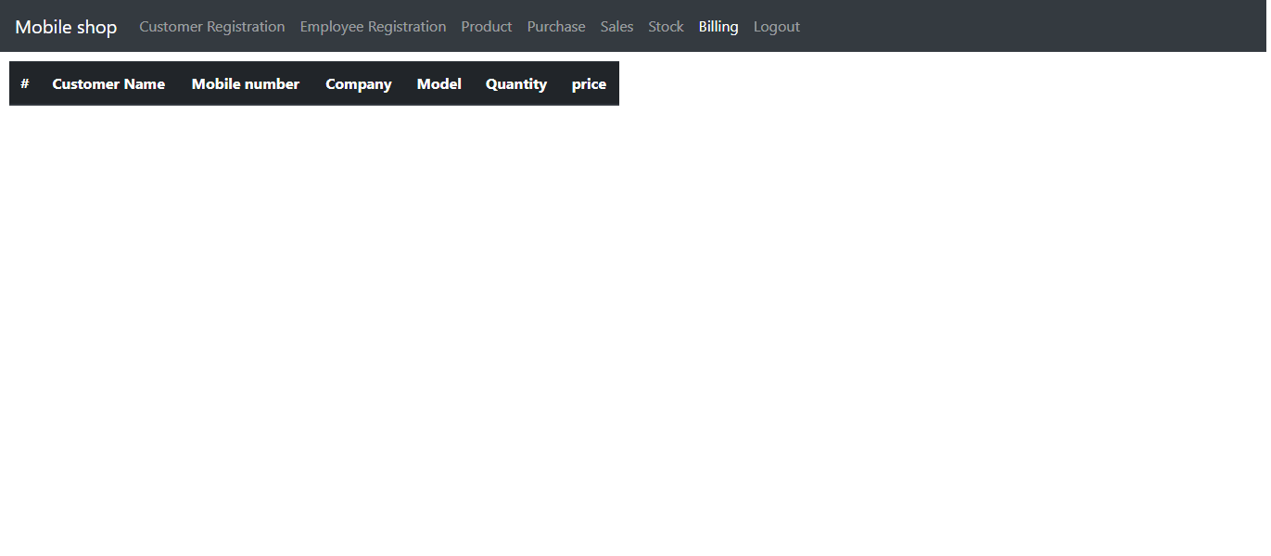

Slide 15
THANK YOU

